Slide 1
Securing DB2 data – Part 1
- ParvathaVardhini Kannan

Slide 2
Agenda
Evolution of Security in DB2
Why security views are not the ideal solution ?
ROW ACCESS
COLUMN MASK
2
Notes:
DB2 Security is a very vast topic. I will be covering only very few aspects of it.
2

Slide 3
Evolution of Security in DB2
June 1985 V1 : SQL GRANT and REVOKE statement,
No secondary AUTHIDs
Sep 1988 V2 : Secondary AUTHID introduced,
Improved Sign On and Exist procedures,
Capability to generate audit traces ,
the resource limit facility (RLF) was introduced,
DBMS enforced referential integrity,
distributed data facility (DDF) address space
Dec 1993 V3 :Archive DB2 recovery log read capability
enhanced for audit reporting of changes
Nov 1995 V4 : The RACF/DB2 interface is delivered,
allowing customers to define and control access
to DB2 resources from the external security
manager
3

Slide 4
Evolution of Security in DB2
June 1997 V5 : DB2 with IBM DB2 Connect™, introduced 56-
bit single DES encryption on ID & password
flows. RACF/DB interface was improved to
provide protection for additional resource types
Mar 2004 V8 : Additional synergy is seen with RACF with
the introduction of multilevel security or MLS,
through the SECLABEL SQL parameter
June 2007 V9 : offers SSL encryption using a new secure port,
introduced the use of roles & network trusted
contexts, allows the application server to propagate user IDs to DB2, uses Enterprise Identity Mapping for improved DB2 & RACF auditing, uses ROLEs for access control & objects owned by ROLES, & uses special registers to
manage object resolution instead of SQLIDs.
4

Slide 5
Evolution of Security in DB2
V10 : Security, regulatory compliance, & audit
capability improvements are included in DB210, provides granular authorities & system parameters that separate data access from the administration of security, application, database & system.
application based row access control &
column masking of sensitive information,
define & create different audit policies to
address the various security needs of business
5

Slide 6
Why security views are not the ideal solutions
VIEW name and base table name should be different, and VIEW name should be unique.
When the number of row and column restrictions increases, the number of views required to manage these restriction could increase tremendously.
Super users like SYSADM will be able to access the base table data without any restrictions.

Slide 7
Solution provided in DB2 V10
Managing security using Row Column Access Control (RCAC)
Row Permissions
Column Masks

Slide 8
Managing Access through RCAC
- Row Column Access Control
Row and column access control enables to manage access to a table at the level of a row, a column, or both.
Row and column access control is a DB2 security solution that uses SQL to control access to a table at the level of a row, a column, or both
8

Slide 9
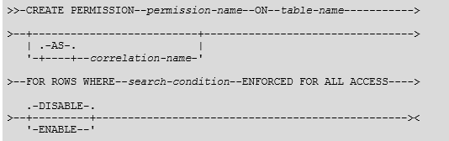
Row Permission:
A row permission is a database object that describes a specific row access control rule for a table. In the form of an SQL search condition, the rule specifies the conditions under which a user, group, or role can access the rows of data in the table.
9
Notes:
If we do not specify any where condition, the permission is applied to all rows in the table
9

Slide 10
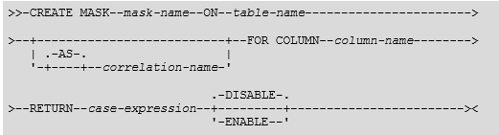
Column Mask:
A column mask is a database object that describes a specific column access control rule for a column. In the form of an SQL CASE expression, the rule specifies the condition under which a user, group, or role can receive the masked values that are returned for a column.
10
Notes:
When Column is defined as NOT NULL some value should be given in ELSE part of the CASE expression. otherwise error occurs as NULL value cannot be assigned SQLCODE = -20373
10

Slide 11
RCAC - Row Column Access Control
When designing row-level or column-level access control for a table, first create the row permissions or column masks to avoid multiple invalidations to packages and dynamically cached statements. After you create row permissions or column masks, use the ALTER TABLE statement to activate row-level or column-level access control for the table. If you must drop or alter a column mask, first activate row-level access control to prevent access to the table, and then drop or alter the column mask. Otherwise, the rows are accessible, but the column values inside the rows are not protected.
If a security administrator with SECADM authority activates row-level access control before the explicit creation of the row permission database object, a default row permission is created. This default row permission blocks all access to the table, including access by the owner.
11

Slide 12
Activating the RCAC
ALTER PERMISSION permissionname
ENABLE / DISABLE/ REGENERATE
ALTER MASK maskname
ENABLE / DISABLE / REGENERATE
ALTER TABLE tablename
ACTIVATE COLUMN ACCESS CONTROL;
ALTER TABLE tablename
ACTIVATE ROW ACCESS CONTROL;
12
Notes:
Similarly we can DEACTIVATE also.
DDL in BMCDB2 just shows ACTIVE mask stmt. HDDL shows both create mask and activate mask/permission
12

Slide 13
Banking Examples
Determine access control rules for customer service representative
Allow access to all customers of the bank (a row permission)
Mask all INCOME values (a column mask)
Return value 0 for incomes of 25000 and below
Return value 1 for incomes between 25000 and 75000
Return value 2 for incomes between 75000 and 150000
Return value 3 for incomes above 150000
All are in the CSR group (who)
13

Slide 14

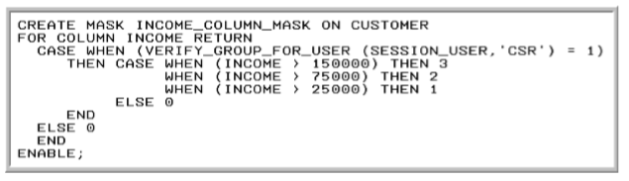

Examples
14

Slide 15

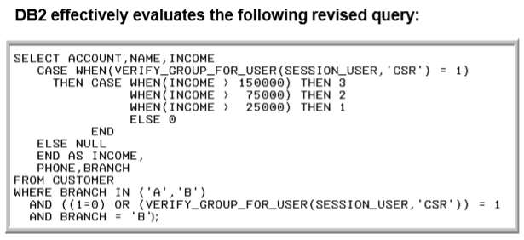
Examples
15

Slide 16
Performing SELECT on a table with COLUMN MASK
The column mask is applied to column C1 that is referenced in the select list of the outermost SELECT clause. It does not interfere with the operations of other clauses within the statement, such as the WHERE, GROUP BY, HAVING, SELECT DISTINCT, or ORDER BY clauses. Some column mask restrictions may apply to the other clauses within the statement.
The masked value that is determined by the evaluation of the CASE expression in the column mask is returned in place of the column value in the output row. If column C1 is embedded in an expression, the column mask is applied to the input column before the evaluation of the expression takes place.
16
Notes:
i.e., by using various WHERE clause values, we can try to guess the masked data
16

Slide 17
Performing DML on a table with RCAC
Only a COLUMN MASK is defined and no row permissions on a table:
When user /role has privilege to read only masked data, they can insert a new row with unmasked data. But it will get masked when read again by same person.
But UPDATE and DELETE is not allowed.
When ROW permission exists :
When a user/ role don’t have access to a table due to Row permission then he will get DSNT408I SQLCODE = -20471, ERROR: THE INSERT OR UPDATE IS NOT ALLOWED BECAUSE A RESULTING ROW DOES NOT SATISFY ROW PERMISSIONS
The row can be inserted only when that row can be subsequently retrieved by the authorization ID of the INSERT statement.
17

Slide 18
Executing IBM Utilities on a table with RCAC
Only for utilities CATMAIN and CROSS LOADER, special considerations to be done when executing on a table with RCAC.
All other utilities like : LOAD, UNLOAD, REORG, COPY, RUNSTATS can be executed without any special considerations.
18
Notes:
Provided the user / role has access to execute the utilities on the table.
For vendor utilities refer VENDOR manuals .
18

Slide 19
Dropping the RCAC
After issuing the DROP MASK statement to remove the existing column mask, do not issue COMMIT immediately
This will prevent any ongoing transactions from accessing table before you can put a new column mask in place.
DB2 invalidates all packages and dynamic cached statements that reference table on which the MASK is dropped or created. It also deletes / inserts the row for MASK in the catalog table SYSIBM.SYSCONTROLS. Since there isn't a COMMIT statement immediately after the DROP MASK statement, DB2 keeps possessing the lock on the table and doesn't commit the work it has done for the DROP MASK statement. Any transactions that try to access table may be timed out.
Once the new MASK is created then COMMIT. This will allow table to be accessed
19
Notes:
19

Slide 20
References
IBM DB2 Manuals, Redbooks, information from IBM Knowledge center, Migration planning workshop presentations, IBM presentations
Discussions in DB2Listserv
Past IDUG / RUG presentations
Blogs by Dave Beulke
Robert Catterall’s blog
i.e., resources available on the topic by googling ☺
20

